Slide 1


i2s Business Solutions Pvt Ltd.
Presenters
Krishnaraju
Rajasekhar and
Gayathri

Slide 2
Agenda
Organization Overview.
Client Engagements.
Delivery Approach and Customer Engagements.
BPM Demo with Live Scenario on Enquiry Management.

Slide 3


Organization Overview
Founded in 2004, a leading IBM Business Partner in ASEAN and Middle East, servicing over 50 customers.
Headquartered in Singapore, with dedicated offshore center in Kuala Lumpur – Malaysia and Bangalore --- India.
Operaing Countries - Singapore, Malaysia, Philippines, Indonesia, Thailand, Mexico, UAE, Qatar, Kuwait and India.
Market Relevance - Business Analyics & opimizaion, Datawarehouse, Big Data implementaions , Enterprise Markeing Management soluions , Business Process Management Soluions (BPM), Mobile First related competencies

Slide 4
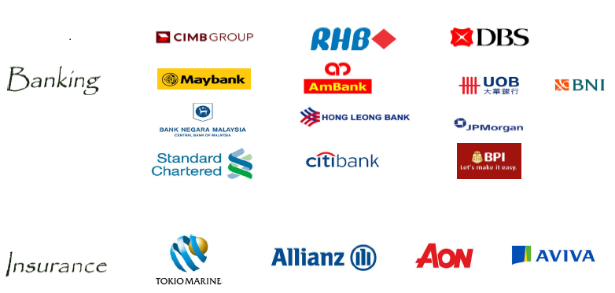
Client Engagement

Slide 5
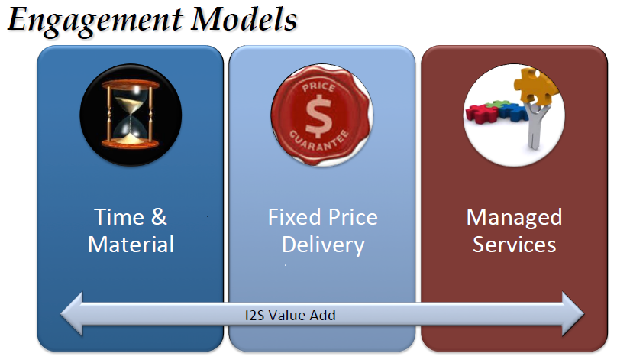
Delivery Approach and Customer Engagements

Slide 6
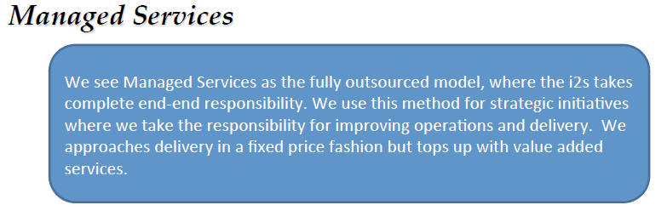
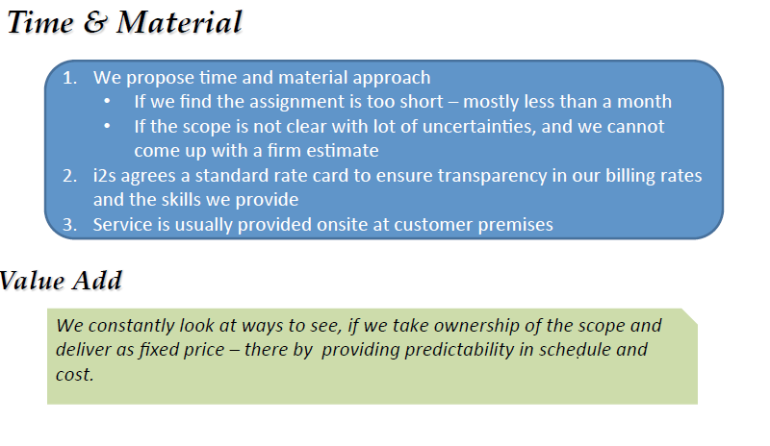
Delivery Approach and Customer Engagements

Slide 7
Customer Engagements
List of on going projects with GDM engagement:
Leading Bank in Malaysia – 35 member team
Leading Telecom alliance in SriLanka – 13 member team
Leading Telecom Service provider in Thailand – 20 member team
Multi-National retailer in Singapore – 10 member team
Leading shipping company in Singapore – 5 member team
Leading Telecom Service provider in Malaysia – 15 member team

Slide 8
BPM Scenario Demonstration
Business Scenario:
Sales happens manually by visiting the customer premise or organisation. Sales information system provides the provisioning of customer order by providing incremental order information by obtaining formal approvals from respective departments for initiating the order there by delaying the order processing and also impact the revenue generation on the sales.
This was trigger point, where order processing invocation system was proposed to automate the interaction and workflow management in order to avoid any delays with approval process and enhance the customer satisfaction and revenue management.

Slide 9
BPM Scenario Demonstration
Demo Scenario:
Demo Mainly focus on the credit evaluation process during the initiation of the order management system which happens in existing CRM application with integration with BPM.
Check for Customer eligibility for buying the Product, system will trigger the notification as a workflow management to Supervisor for approval process. Upon successful approval order is placed.
Customer request for sales person to provision the amendments for the delay in taking the decision to purchase a particular product.

Slide 10


